Slide 1
Recovery for All
Tim Richter
June 5, 2020
May 1, 2019

Slide 2


The Canadian Alliance to End Homelessness
The CAEH leads a national movement of individuals, organizations and communities working together to end homelessness in Canada.
caeh.ca
National Conference on
Ending Homelessness
Join us in Edmonton for the 2019 National Conference on Ending Homelessness.
conference.caeh.ca
Built for Zero Canada
An ambitious national change effort helping a core group of leading communities end chronic homelessness - a first step on the path to eliminating all homelessness in Canada.
bfzcanada.ca
Training & Technical Assistance
Helping communities and organizations end homelessness with expert training and technical assistance.
training.caeh.ca
Allied Networks
The CAEH supports several allied networks working toward our shared mission of ending homelessness.
caeh.ca

Slide 3
Our Strategy for Ending Homelessness
WIDELY HELD EXPECTATION AMONG KEY INFLUENCERS THAT HOMELESSNESS BE ENDED
END HOMELESSNESS IN CANADA
FEDERAL POLICY REFORM
RECONCILIATION
PROVINCIAL SYSTEMS RE-ALIGNED TO SUPPORT AN END TO HOMELESSNESS
LOCAL SYSTEMS SET UP TO DRIVE & SUSTAIN REDUCTIONS
TECHNICAL SKILLS FOR ENDING HOMELESSNESS
Notes:
I’m going to focus

Slide 4
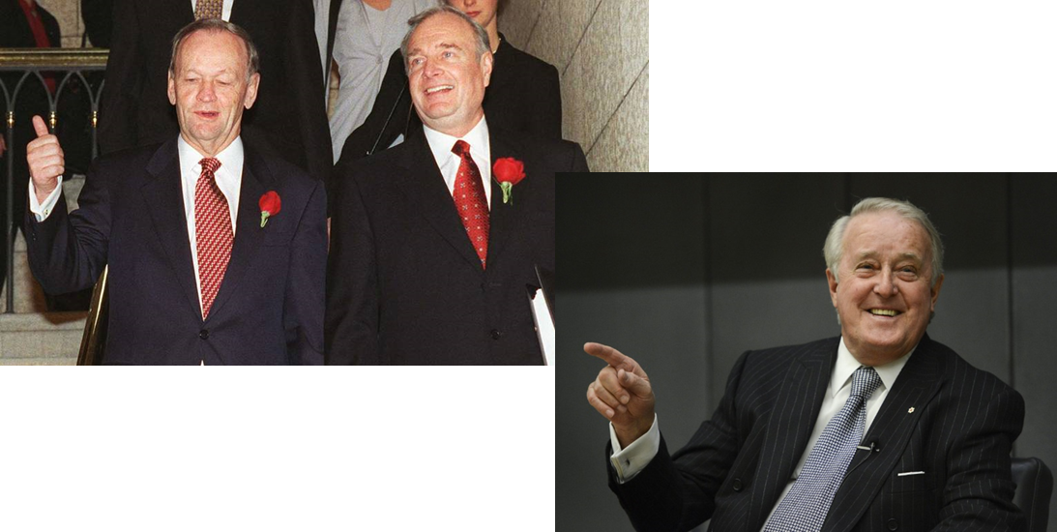
Homelessness was Created by Policy
Notes:
Mass homelessness like we see it today hasn’t always existed

Slide 5

Modern Mass Homelessness in Canada
235,000 different people per year
35,000 on any given night
Costs over $7 Billion per year
Reduces life expectancy by 25 years. Average ‘age at death’ 50 years.

Slide 6
Opportunity
“A crisis can lead to pushing those in charge to set aside ordinary politics and conventional policymaking and to think big - very big. The extreme conditions clear away the institutional and political barriers that ordinarily make radical solutions impossible to effect ... [we have] a once in a generation chance to turn adversity into advantage and rewrite the rules, recognizing the rare freedom those circumstances afforded...”
  The Fix: How Countries use crisis to solve the worlds worst problems” – Jonathan Tepperman

Slide 7
Opportunity
We can never – must never - go back to “normal”.
COVID-19 is exposing the extreme vulnerability homelessness create. We can never go back to the old normal.
Public empathy – for now.
Government is ‘setting aside ordinary politics and conventional policymaking’ – for now.
Planning for recovery is beginning
Unique political situation with a ‘progressive’ federal Parliament & supportive government

Slide 8

https://www.recoveryforall.ca

Slide 9
A Six Point Plan for Ending Homelessness
A Federal commitment (with timelines and targets) to the prevention and elimination of homelessness with expanded federal investment in community-based homelessness responses.
A national guaranteed minimum income to ensure those in greatest need have minimum financial resources to help them meet their basic needs and prevent homelessness when times are tough.
Construction of 300,000 new permanently affordable and supportive housing units and enhanced rental support for low-income Canadians to address Canada’s housing and homelessness crisis.
Meaningful implementation of the right to housing to surface and resolve inequities and systemic/structural breakdowns that contribute to homelessness and housing need.
Implementation of measures to curtail the impacts of financialization of rental housing markets by limiting the ability of large capital funds to purchase ‘distressed’ rental housing assets.
Implementation of an Urban and Rural Indigenous Housing and Homelessness Strategy that is developed and implemented by urban, rural and Northern Indigenous peoples and housing and service providers.
Notes:
Be enough to get us well on the road to ending homelessness
Allow us to build a coalition ensuring partners could see enough of themselves in it to support – without being a 600 point plan

Slide 10
Strategy
Premised on “4 Campaign Realities” (https://northweather.com/team)
    Everyone is an influencer
    Everyone is a media company
    Supporters are the new oxygen
    Campaign brands are built to engage on specific issues
RFA is a digital lead campaign centred on:
    identifying, recruiting and mobilizing a large number of supporters using progressive engagement
    enabling immediate action to help pressure decision-makers
Immediate goal is to accumulate at minimum of 10,000 supporters in 90-days and activate those supporters to communicate with Members of Parliament.
Beyond our policy objectives, Recovery for All is testing strategies for a more ambitious plan to transform the CAEH into a campaigning organization.

Slide 11







Activities
Website
Video
Organic social media
Stakeholder Outreach
Drip Campaign
Earned Media

Slide 12


Slide 13


Slide 14







Thank You
Tim Richter, President & CEO
(587) 216-5615
tim@caeh.ca
caeh.ca
@timrichter
@endinghomelessness
@CAEHomelessness
@CAEHomelessness
Canadian Alliance to End Homelessness

