Slide 1
After the pandemic…
Campaigning for the beginning of end of homelessness

Slide 2
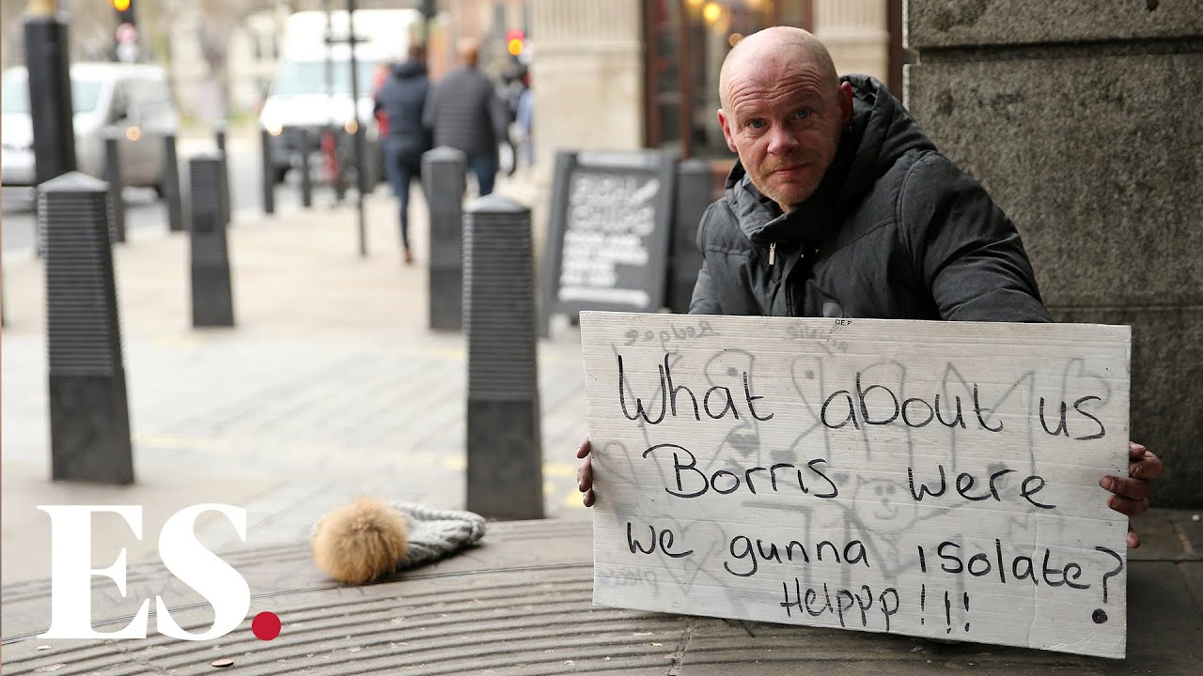

Slide 3
Over the last 10 weeks…
15,000+ people moved off the street, shelters, etc.
£1bn investment into Housing Benefit
Domestic abuse survivors given right to rehousing
Suspension of evictions from the PRS, and from asylum accommodation
Legal tests for migrant populations suspended
Scottish and Welsh governments have seized the moment to fast-track plans to end homelessness

Slide 4
But in less than one month…
15,000 in England people will either be housed… or not.
This is a month unlike any other in the fight against homelessness

Slide 5
Changing your own organisation
Two new Housing First programmes (London and Newcastle)
Grant programme for 200+ local NGOs
A new grant scheme for service transition
Direct help to local government*
Investment in resettlement workers across a range of cities
Notes:
*see here for tools and guidance for local government: https://www.crisis.org.uk/ending-homelessness/resources-for-practitioners/covid-19-transition-planning/

Slide 6
What are we asking for?
Emergency legislation to halt evictions and provide housing for those homeless in the pandemic
National roll-out of Housing First across England
Suspension of legal barriers for people from outside the UK

Slide 7
Solutions focussed advocacy
A fully drafted Homelessness (Covid-19 Response) Bill
Modelling of the services needed and the costs of them
Cross-party political supporters
A constituency of public and specialist support for the campaign

